Slide 1
THE FINE-TUNING DATA
IT APPEARS THAT THE CONSTANTS (PARAMETERS) OF SOME OF THE KNOWN LAWS OF NATURE ARE “FINE-TUNED” SO THAT THEY ARE LIFE-PERMITTING. THIS DOESN’T MEAN THAT SOMEBODY FINE-TUNED THEM.
ALSO IT APPEARS THAT THE INITIAL CONDITIONS OF THE UNIVERSE, “THE BIG BANG” ARE FINE-TUNED FOR LIFE.

Slide 2
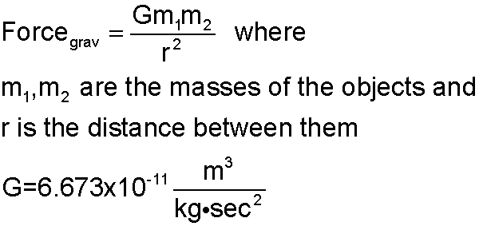
LAWS AND PARAMETERS (CONSTANTS) THE LAW OF GRAVITATION

Slide 3
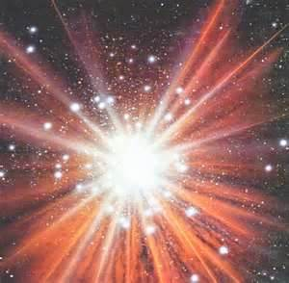
THE BIG BANG (13.74 BILLION YEARS AGO)

Slide 4
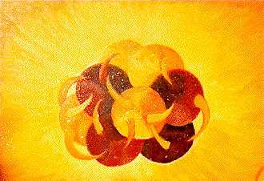
THE STRONG NUCLEAR FORCE

Slide 5
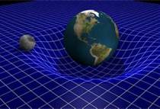
GRAVITY

Slide 6
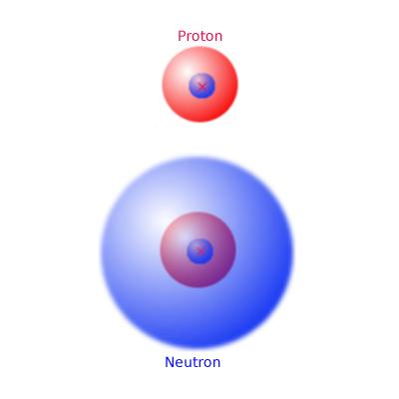
RELATIVE MASS OF NEUTRON AND PROTON

Slide 7

ELECTROMAGNETIC FORCE

Slide 8
THE MAIN ARGUMENT COLLINS OFFERS USES THE FOLLOWING PRINCIPLE
PPC. An observation counts in favor of (more highly confirms) the hypothesis under which the observation has the highest probability.
COLLINS ILLUSTRATES THIS PRINCIPLE WITH VARIOUS EXAMPLES. IT CAN BE SHOWN TO BE A CONSEQUENCE OF THE AXIOMS OF PROBABILITY THEORY.

Slide 9
THE MAIN FINE-TUNING ARGUMENT: FIRST TWO PREMISES
Premise 1. The existence of the fine-tuning is not improbable under Theistic Design Hypothesis.
Premise 2. The existence of the fine-tuning is very improbable under the atheistic Single (Unique) Universe Hypothesis (p. 150)

Slide 10
THIRD PREMISE: THE PRIME PRINCIPLE OF CONFIRMATION
Premise PPC. An observation counts in favor of (more highly confirms) the hypothesis under which the observation has the highest probability.

Slide 11
CONCLUSION
(C) The fine-tuning data provides stronger evidence for the Theistic Design Hypothesis than for the atheistic Single Universe Hypothesis

Slide 12
THIS ARGUMENT IS DEDUCTIVELY VALID
GIVEN THE PREMISES OF THIS ARGUMENT, WE CAN CONCLUDE THAT THE FINE-TUNING DATA CONFIRMS THEISM MORE THAN IT CONFIRMS THE ATHEISTIC SINGLE-UNIVERSE HYPOTHESIS. ARE THE PREMISES TRUE (OR AT LEAST REASONABLE)?

Slide 13
COLLINS OFFERS SUPPORT FOR THE PREMISES
IF WE TAKE THE THEISTIC DESIGN HYPOTHESIS TO BE:
(TDH) God is all-good, created the Universe and actualized the laws of nature.
AND TAKE THIS TOGETHER WITH THE ASSUMPTION:
The Universe is better with life in it than it would have been without life¹ (THIS IS NOT QUITE THE ASSUMPTION THAT COLLINS MAKES)

Slide 14
WE HAVE EMENDED THE PREMISE USED HERE
COLLINS ACTUALLY USES: “It is good for intelligent conscious beings to exist”. WHILE THIS MAY BE TRUE, IT DOES NOT REALLY SUFFICE TO PRODUCE AN INDUCTIVELY STRONG ARGUMENT (FOR PREMISE 2 OF THE MAIN ARGUMENT). THE PREMISE I HAVE ADDED DOES PRODUCE AN INDUCTIVELY STRONG ARGUMENT AND, MOREOVER, SEEMS REASONABLE (SEE FOOTNOTE 1).

Slide 15
WE GET AN INDUCTIVELY STRONG ARGUMENT FOR:
(C) THE LAWS OF NATURE AND INITIAL CONDITIONS OF THE UNIVERSE ARE FINE-TUNED TO BE LIFE PERMITTING.

Slide 16
AS FOR THE SECOND PREMISE
COLLINS CLAIMS (IN EFFECT) THAT THE FOLLOWING ARGUMENT IS NOT INDUCTIVELY STRONG (INDEED, THAT IT IS INDUCTIVELY WEAK). PREMISE:
(UH) THERE IS A SINGLE UNIVERSE AND IT IS A BRUTE FACT THAT THE LAWS OF NATURE AND INITIAL CONDITIONS ARE AS THEY ARE.

Slide 17
AGAIN THE CONCLUSION:
(C) THE LAWS OF NATURE AND INITIAL CONDITIONS OF THE UNIVERSE ARE FINE-TUNED TO BE LIFE PERMITTING.

Slide 18
BUT UH AS PREMISE DOES NOT PRODUCE AN INDUCTIVELY STRONG ARGUMENT FOR THE CONCLUSION:
(C)THE LAWS OF NATURE AND INITIAL CONDITIONS ARE FINE-TUNED SO AS TO BE LIFE-PERMITTING.

Slide 19
COLLINS CONSIDERS FOUR OBJECTIONS TO THIS ARGUMENT
OBJECTION 1: MORE FUNDAMENTAL LAWS OBJECTION.
OBJECTION 2: OTHER FORMS OF LIFE OBJECTION.
OBJECTION 3: ANTHROPIC PRINCIPLE OBJECTION
OBJECTION 4: THE “WHO DESIGNED GOD?” OBJECTION.

Slide 20
THE MORE FUNDAMENTAL LAWS OBJECTION
“THERE COULD BE A MORE FUNDAMENTAL LAW UNDER WHICH THE CONSTANTS OF THE KNOWN LAWS MUST HAVE THESE LIFE-PERMITTING VALUES.”
COLLINS’S REPLY: THIS JUST MOVES THE PROBLEM “UP ONE LEVEL”. IF THE MORE FUNDAMENTAL LAW IS “BRUTE”, THEN WE CAN ARGUE THAT THE FINE-TUNING DATA STILL CONFIRMS THEISM MORE THAN THAT LAW.

Slide 21
THE “WHO DESIGNED GOD” OBJECTION
“THE THEISTIC HYPOTHESIS DOES NOT SOLVE THE PROBLEM OF APPARENT DESIGN, IT JUST TRANSFERS IT UP ONE LEVEL: WHO DESIGNED GOD? GOD MUST BE AT LEAST AS COMPLEX AS THE COMPLEXITY OF THE WORLD.”
COLLINS’S REPLIES:
(i) IT IS NOT EVIDENT THAT SOMETHING THAT DESIGNS AND PRODUCES A COMPLEX ENTITY MUST BE AT LEAST AS COMPLEX AS THE PRODUCE.

Slide 22
ANYWAY (SAYS COLLINS) THE OBJECTION IS IRRELEVANT
COLLINS’S SECOND REPLY:
(ii) THE OBJECTION IS DIRECTED AGAINST A VERSION OF THE DESIGN ARGUMENT THAT PURPORTS TO HAVE A HYPOTHESIS THAT EXPLAINS ALL THE ORGANIZED COMPLEXITY THAT THERE IS. THE PRESENT ARGUMENT ONLY ARGUES THAT THE THEISTIC HYPOTHESIS BETTER EXPLAINS THE FINE-TUNING OF THE LAWS OF NATURE AND INITIAL CONDITIONS.

Slide 23
THE OTHER FORMS OF LIFE OBJECTION
“OTHER FORMS OF LIFE MIGHT EXIST EVEN IF THE PARAMETERS OF PHYSICS WERE DIFFERENT.”
COLLINS’S REPLY: ALMOST CERTAINLY THE LEVEL OF COMPLEXITY REQUIRED FOR LIFE COULD NOT EXIST IF SUCH THINGS AS GRAVITY, THE ELECTROMAGNETIC FORCE, THE FORCE OF THE BIG BANG, AND THE RELATIVE MASS OF THE NEUTRON AND PROTONS. (THERE ARE MANY OTHER EXAMPLES OF FINE-TUNING NECESSARY FOR LIFE).

Slide 24
ANTHROPIC PRINCIPLE OBJECTION
“THE FINE-TUNING OF THE LAWS OF NATURE AND INITIAL CONDITIONS ARE NOT IMPROBABLE AT ALL: IF THERE WEREN’T FINE-TUNING, WE WOULDN’T BE HERE TO OBSERVE IT!”
COLLINS REPLIES: WE COULD RESTATE THE ARGUMENT SO THAT DATA STATES THAT THE FINE-TUNING IS EMBODIED, INTELLIGENT BEING PERMITTING – I.E. PERMITS OUR EXISTENCE.

Slide 25
COLLINS ILLUSTRATES THE RESPONSE
SUPPOSE ALL THE MARKSMEN MISS ME WHEN I AM IN FRONT OF A FIRING SQUAD. THE HYPOTHESIS THAT THEY ALL MISSED ME BY CHANCE (OR FOR NO REASON) IS MUCH LESS PROBABLE ON MY EXISTENCE AS EVIDENCE THAN THE HYPOTHESIS THAT THEY ALL INTENDED TO MISS. (THOUGHT EXPERIMENT IS DUE TO JOHN LESLIE).
THE REPLY TO THIS IS OBJECTION (ACCORDING TO COLLINS) IS SIMILAR.

Slide 26
COLLINS THEN CONSIDERS THE ATHEISTIC MANY-UNIVERSES HYPOTHESIS
THE REASONS COLLINS OFFERS FOR “REJECTING” THIS HYPOTHESIS ARE ENTIRELY INDEPENDENT FROM THE MAIN ARGUMENT JUST DISCUSSED. IN EFFECT, HE IS ARGUING THAT ON CERTAIN OTHER DATAS (THE SECOND LAW OF THERMODYNAMICS, PROBLEMS EXPLAINING THE EXISTENCE OF “UNIVERSE GENERATORS”, THAT THIS IS NOT A “NATURAL EXTRAPOLATION FROM OUR EXPERIENCE”, THE BEAUTY OF THE LAWS OF NATURE.)

Slide 27
WE DO NOT HAVE TIME TO DISCUSS HIS OBJECTIONS TO THIS HYPOTHESIS
COLLINS GIVES FIVE REASONS TO “REJECT” THE ATHESTIC MANY WORLDS HYPOTHESIS. WE WILL NOT DISCUSS THEM AND THEY WILL NOT BE COVERED ON THE EXAM.

Slide 28
TO AVOID COMPLICATIONS, WE LEAVE SOME DETAILS ASIDE HERE
NOTE WELL, THAT (AS ALWAYS) WE MUST RESPECT THE REQUIREMENT OF TOTAL EVIDENCE . THE ULTIMATE QUESTION IS: WHAT HAPPENS WHEN WE ADD THE FINE-TUNING DATA TO OUR OTHER EVIDENCE IN FAVOR OF THEISM?
THIS IS TO BE COMPARED WITH THE DATA (E.G. THE EXISTENCE OF GREAT EVILS) THAT COUNTS AGAINST THEISM.

